Slide 1
Opioid Overdose Predictive Model by MachineBreakers
Santosh Yadav Jada
Aditya Soman
Paras Maharjan
Sai Mohith Reddy Chagamreddy

Slide 2

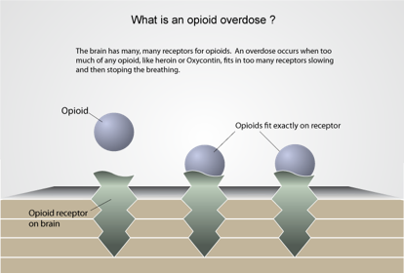
Key Features
Analysis of data using R-studio
Prediction of Opioid Overdose till 2021
Integration of different web technologies to create a website for the information
Data mining using Twitter API
Implementation of different predictive models
Visualization of data.

Slide 3









Technologies & Tools

Slide 4
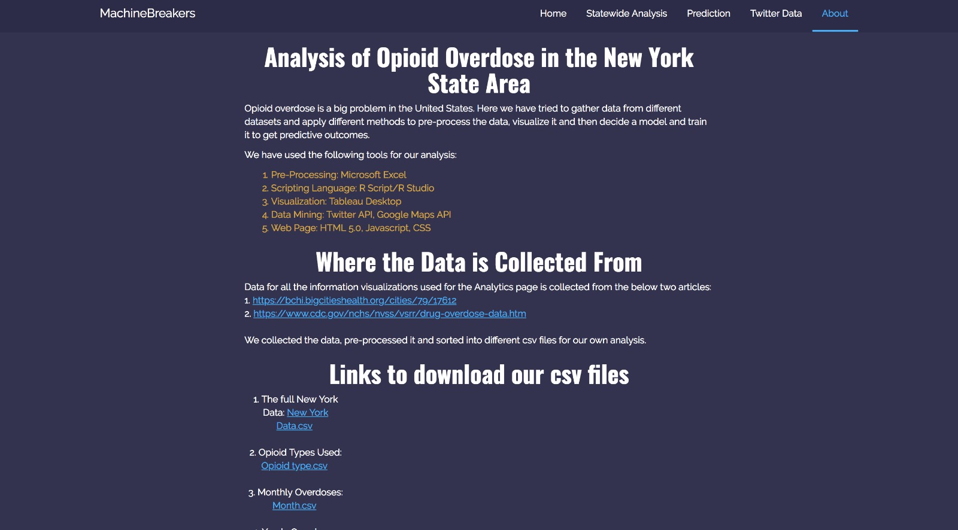
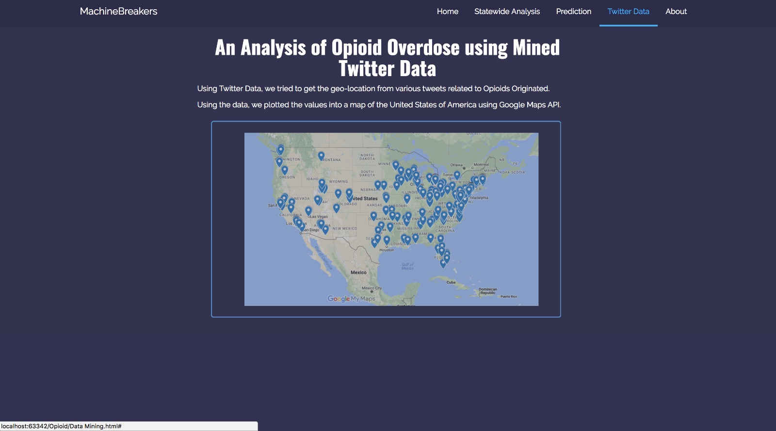
User Interface

